Slide 1
Food Ordering System
Task – 5 : DEPLOYMENT

Slide 2

Food Ordering System
Food Odering System , “Experience convenience at your fingertips with our food ordering system. Browse, choose, and enjoy delicious meals effortlessly from your favorite restaurants.
NM ID | Name | Batch
au421320104006 | BARANI S | 1
au421320104013 | JEEVITHA G | 1
au421320104015 KEERTHIGA M |  | 1
au421320104022 NITHYA K |  | 1

Slide 3
Task 5 :: Hosting (Module 5)
Hosting the website so that it can be accessed from anywhere
Host backend on AWS with all environment setup
Make sure to white list API ports and host with the database
Migrate database to MySQL
Build react app to be hosted on the server
Set hosted backed URL to the frontend
Evaluation Metric:
100% Completion of the above tasks
Learning outcome
Understand how to host a web API
How to deploy production ready react applications
Setting up environment for production

Slide 4

Step-Wise Description
Step 1: Install Render CLI (Command Line Interface).
Step 2: Login to Your Render Account:
Step 3: Initialize a Render Service:
Step 4: Configure render.yaml.
Step 5: Add Service Definition
Step 6: Configure Databases or Other Services (if needed):
Step 7: Push to Git Repository (Optional):
Step 8: Create a New Render Service:
Step 9: Monitor Deployment:
Step 10: Access Your Deployed Task
Summary :
A food ordering system allows users to browse menus, select items, and place orders for delivery or pickup from restaurants through a digital platform, often a website or mobile app..

Slide 5
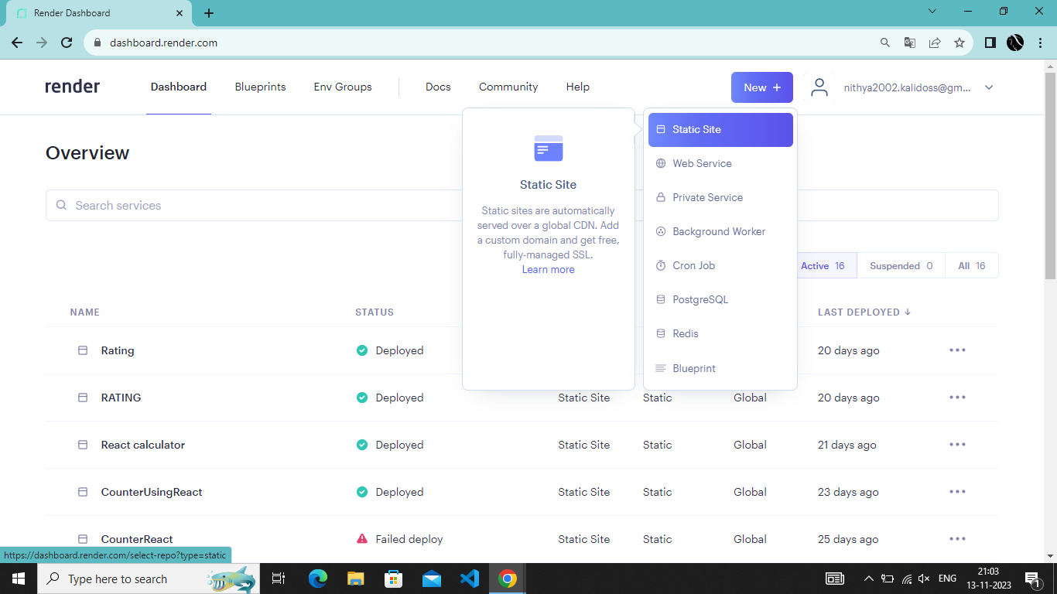

Slide 6
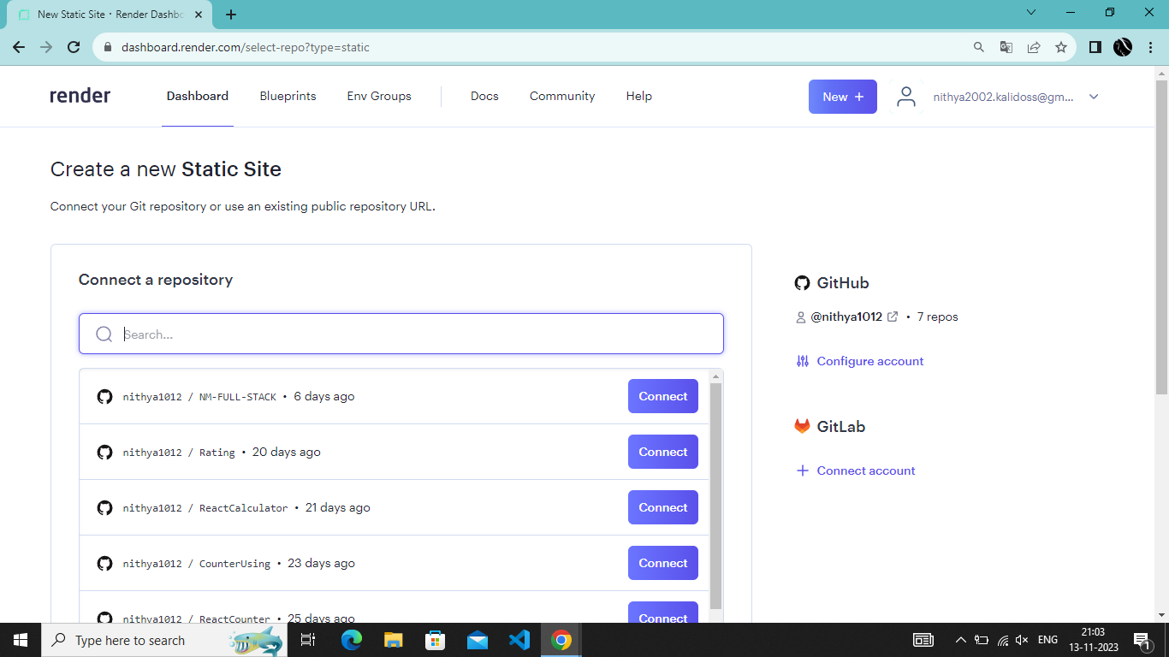

Slide 7
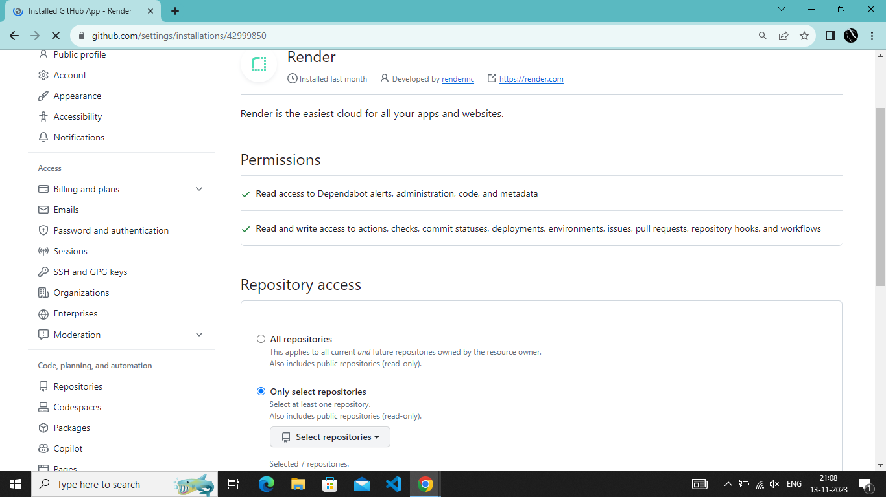

Slide 8
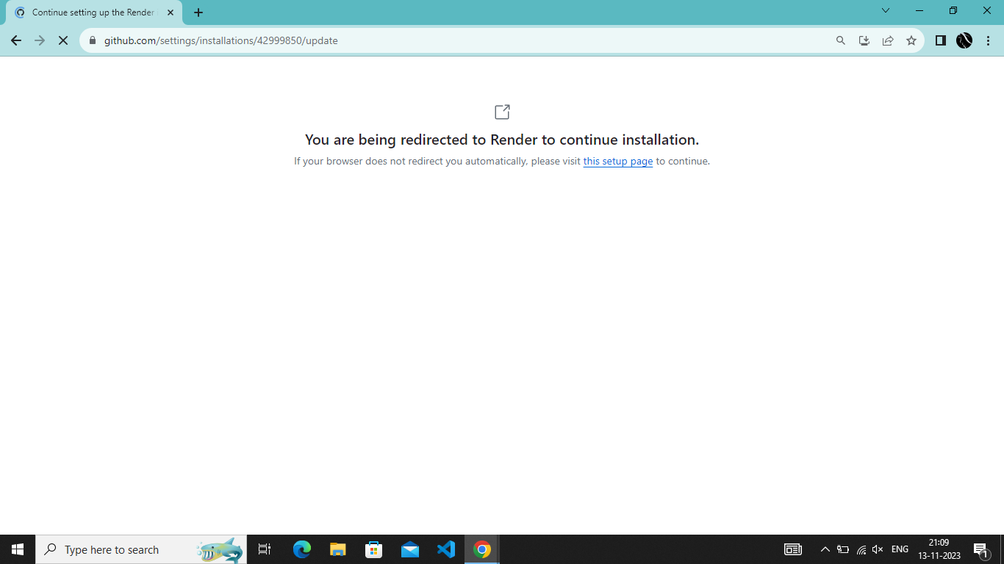

Slide 9
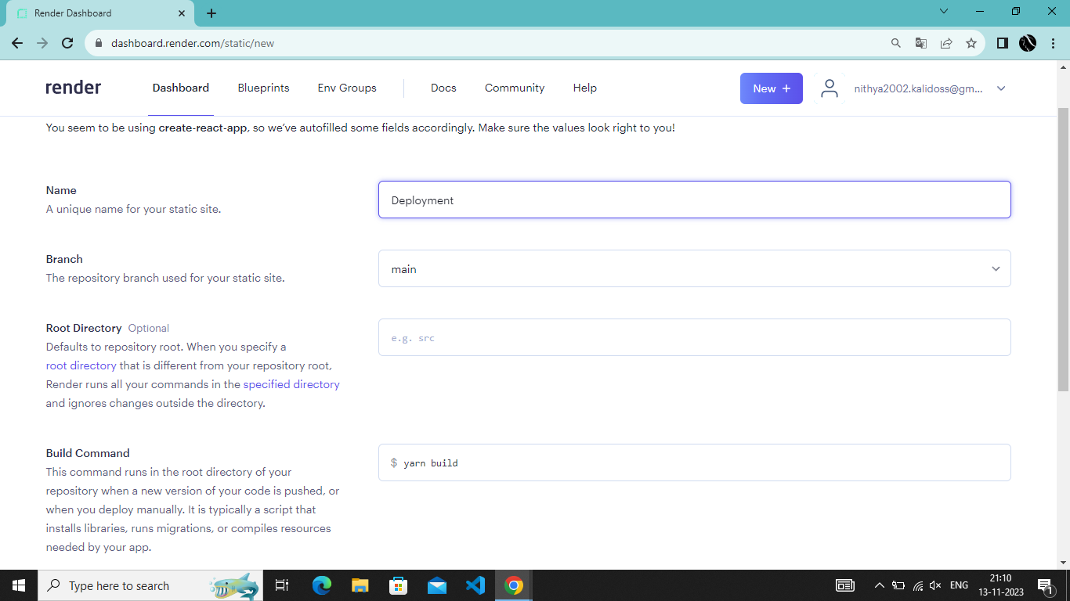

Slide 10
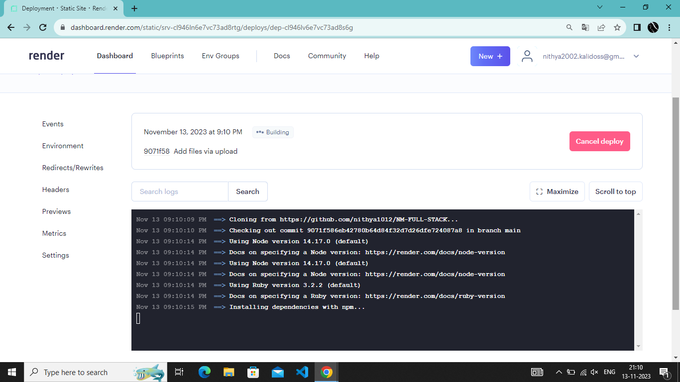

Slide 11
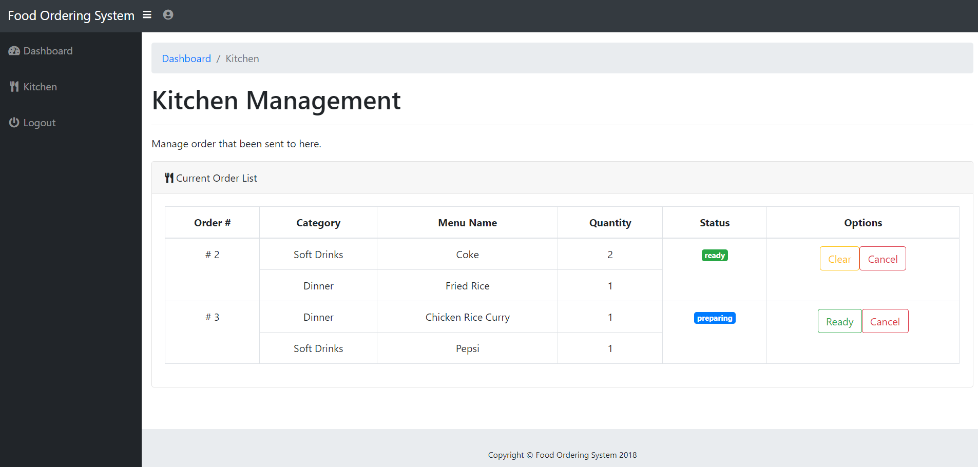

Slide 12
Assessment Parameter
create AWS EC2 instance
build your react application for production
add all dependencies required for deployment
Check-List
forwared required ports on ec2 instance
Migrate entire database to mongodb atlas
set all environment varialble withs appropriate values
run node server on development using pm2 service manager
Host your react application on server

Slide 13
Submission Github
Inset your Github link here

